Slide 1
Mathematical model of discretionary access control policy
Ksenia Sintsova. May 2021

Slide 2
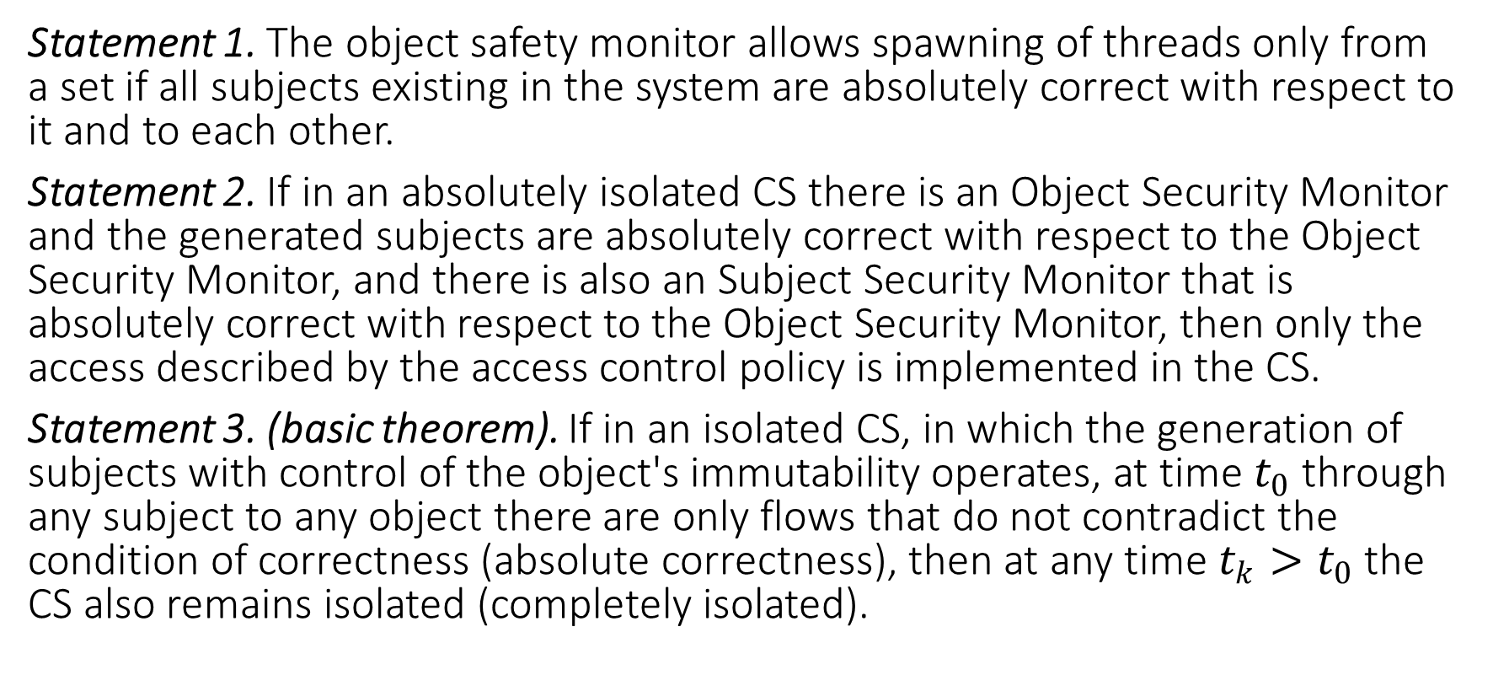
Key statements
Statement 1. The object safety monitor allows spawning of threads only from a set if all subjects existing in the system are absolutely correct with respect to it and to each other.
Statement 2. If in an absolutely isolated CS there is an Object Security Monitor and the generated subjects are absolutely correct with respect to the Object Security Monitor, and there is also an Subject Security Monitor that is absolutely correct with respect to the Object Security Monitor, then only the access described by the access control policy is implemented in the CS.
Statement 3. (basic theorem). If in an isolated CS, in which the generation of subjects with control of the object's immutability operates, at time $t_{0}$ through any subject to any object there are only flows that do not contradict the condition of correctness (absolute correctness), then at any time $t_{k}>t_{0}$the CS also remains isolated (completely isolated).

Slide 3
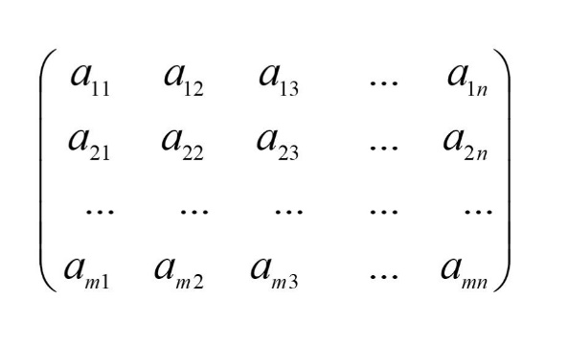
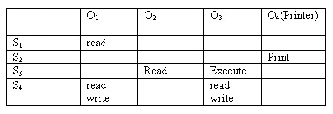
Characterization
Within the framework of discretionary policy, each cell aggregates a subset of the subject-operation (flow) - object triplets. An access matrix is an object associated with a security monitor that contains information on the access control policy in a particular system.

Slide 4
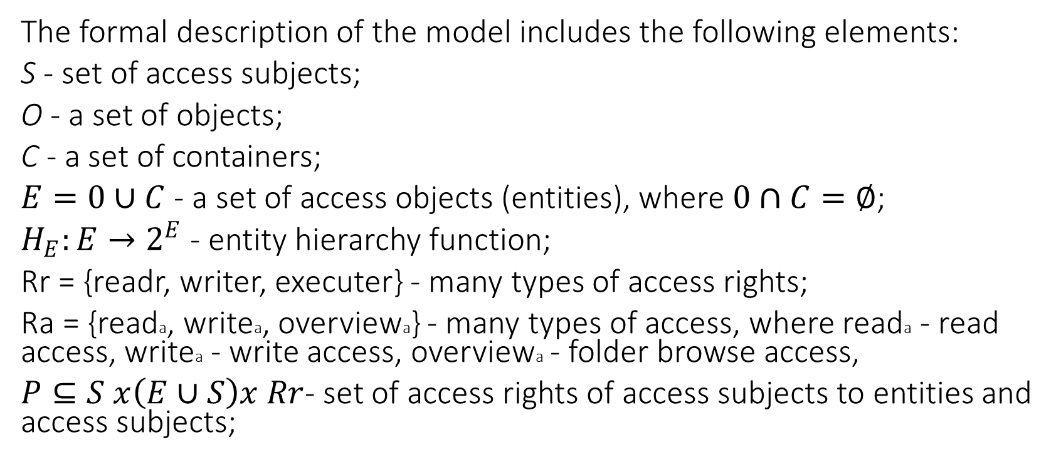
Model Description
The formal description of the model includes the following elements:
S - set of access subjects;
O - a set of objects;
C - a set of containers;
$E=0∪C$- a set of access objects (entities), where $0∩C=∅$;
$H_{E}:E→2^{E}$- entity hierarchy function;
Rr = {readr, writer, executer} - many types of access rights;
Ra = {reada, writea, overviewa} - many types of access, where reada - read access, writea - write access, overviewa - folder browse access,
$P⊆S x\left(E∪S\right)x Rr$- set of access rights of access subjects to entities and access subjects;

Slide 5
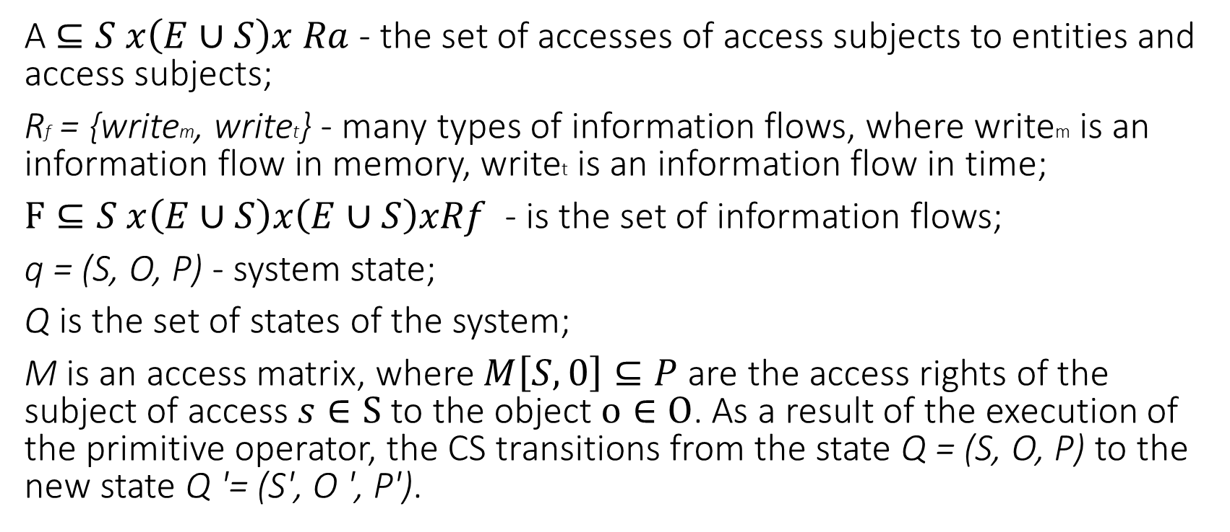
Model Description
A $⊆S x\left(E∪S\right)x Ra$- the set of accesses of access subjects to entities and access subjects;
Rf = {writem, writet} - many types of information flows, where writem is an information flow in memory, writet is an information flow in time;
$F⊆S x\left(E∪S\right)x\left(E∪S\right)xRf$ - is the set of information flows;
q = (S, O, P) - system state;
Q is the set of states of the system;
M is an access matrix, where $M\left[S,0\right]⊆P$are the access rights of the subject of access $s∈S$ to the object $o∈O$. As a result of the execution of the primitive operator, the CS transitions from the state Q = (S, O, P) to the new state Q '= (S', O ', P').

Slide 6
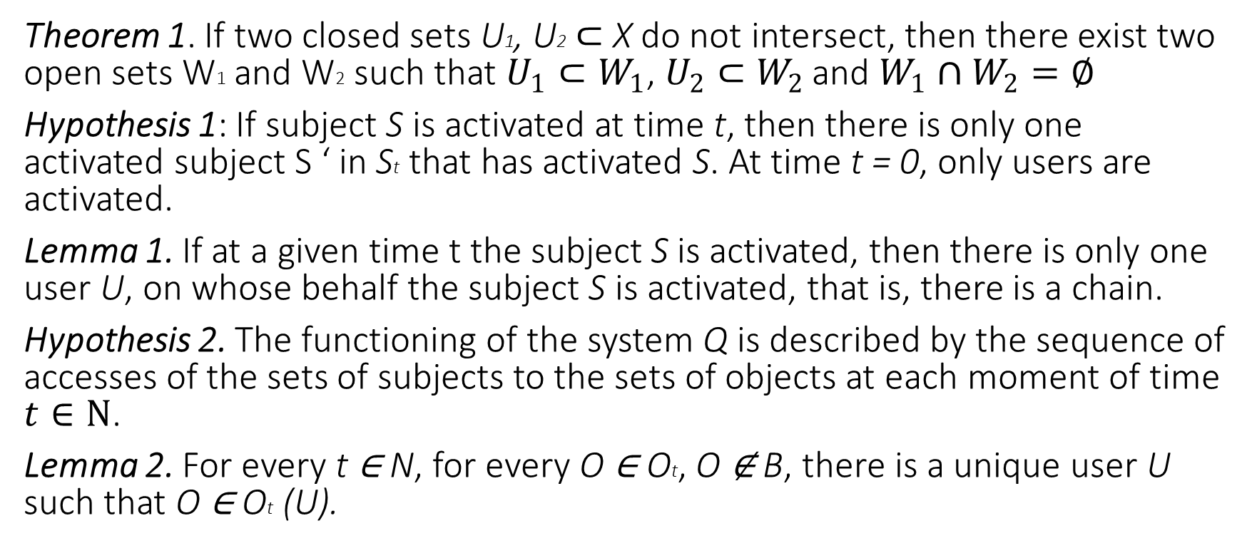
Characterization
Theorem 1. If two closed sets U1, U2$⊂$ X do not intersect, then there exist two open sets W1 and W2 such that $U_{1}⊂W_{1}$, $U_{2}⊂W_{2 }$and $W_{1}∩W_{2}=∅$
Hypothesis 1: If subject S is activated at time t, then there is only one activated subject S ‘ in St that has activated S. At time t = 0, only users are activated.
Lemma 1. If at a given time t the subject S is activated, then there is only one user U, on whose behalf the subject S is activated, that is, there is a chain.
Hypothesis 2. The functioning of the system Q is described by the sequence of accesses of the sets of subjects to the sets of objects at each moment of time $t∈N$.
Lemma 2. For every t ∈ N, for every O ∈ Ot, О ∉ B, there is a unique user U such that O ∈ Ot (U).

Slide 7
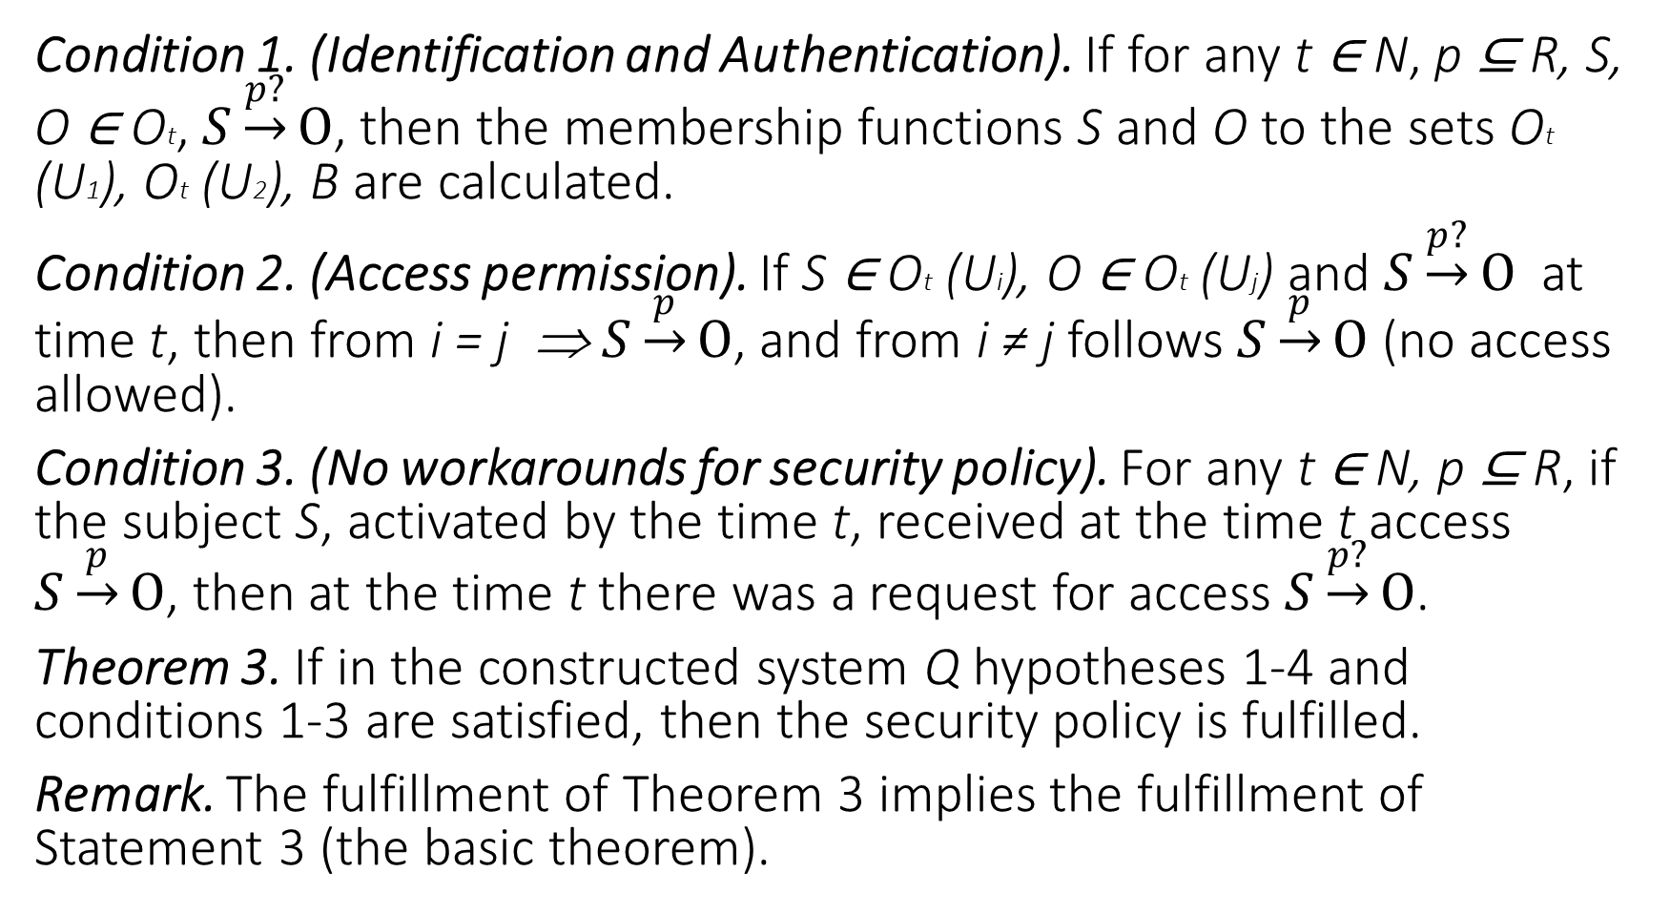
Condition 1. (Identification and Authentication). If for any t ∈ N, p ⊆ R, S, О ∈ Оt, $S\underset{→}{p?}O$, then the membership functions S and О to the sets Оt (U1), Оt (U2), B are calculated.
Condition 2. (Access permission). If S ∈ Оt (Ui), O ∈ Оt (Uj) and $S\underset{→}{p?}O$ at time t, then from i = j ⇒ $S\underset{→}{p}O$, and from i ≠ j follows $S\underset{→}{p}O$ (no access allowed).
Condition 3. (No workarounds for security policy). For any t ∈ N, р ⊆ R, if the subject S, activated by the time t, received at the time t access $S\underset{→}{p}O$, then at the time t there was a request for access $S\underset{→}{p?}O$.
Theorem 3. If in the constructed system Q hypotheses 1-4 and conditions 1-3 are satisfied, then the security policy is fulfilled.
Remark. The fulfillment of Theorem 3 implies the fulfillment of Statement 3 (the basic theorem).

Slide 8
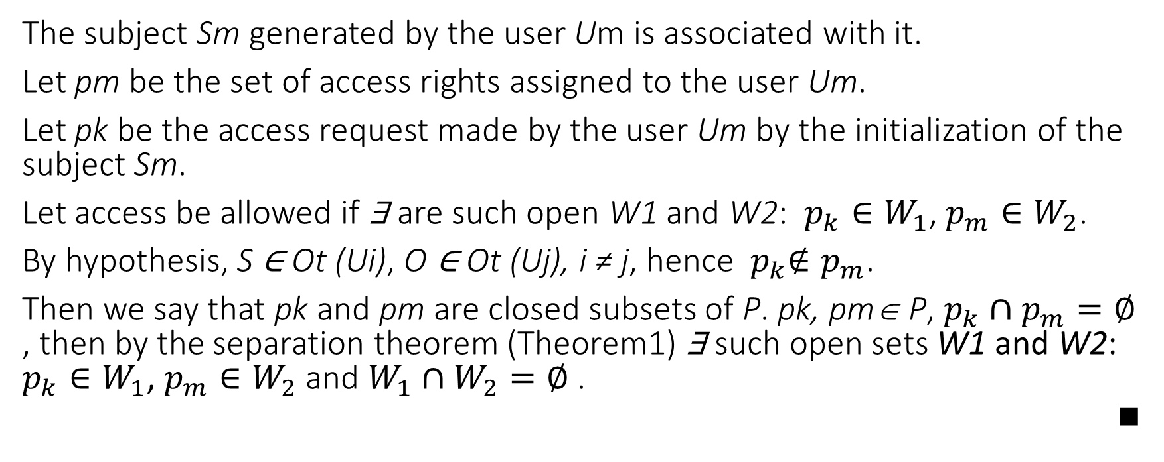
Additional proof of condition 2. (case i ≠ j).
The subject Sm generated by the user Um is associated with it.
Let pm be the set of access rights assigned to the user Um.
Let pk be the access request made by the user Um by the initialization of the subject Sm.
Let access be allowed if ∃ are such open W1 and W2: $p_{k}∈W_{1}$, $p_{m}∈W_{2}$.
By hypothesis, S ∈ Оt (Ui), O ∈ Оt (Uj), i ≠ j, hence ${ p}_{k}∉p_{m}$.
Then we say that pk and pm are closed subsets of P. pk, pm∈ P, $p_{k}∩p_{m}=∅$ , then by the separation theorem (Theorem1) ∃ such open sets W1 and W2: $p_{k}∈W_{1}$, $p_{m}∈W_{2}$ and $W_{1}∩W_{2}=∅$ . ■

Slide 9
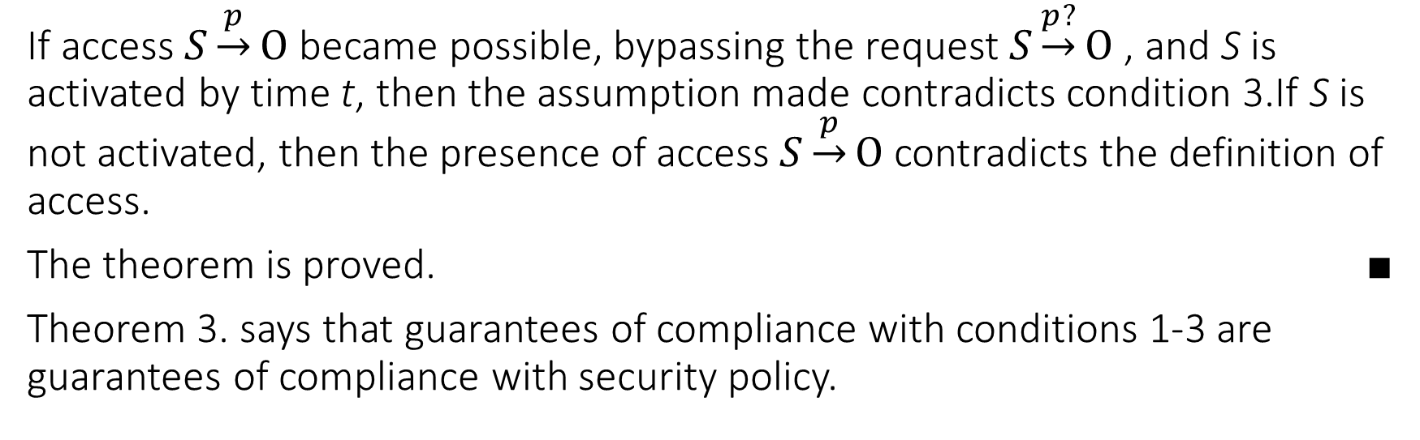
Additional proof of condition 2. (case i ≠ j).
If access $S\underset{→}{p}O$ became possible, bypassing the request $S\underset{→}{p?}O$, and S is activated by time t, then the assumption made contradicts condition 3.If S is not activated, then the presence of access $S\underset{→}{p}O$contradicts the definition of access.
The theorem is proved. ■
Theorem 3. says that guarantees of compliance with conditions 1-3 are guarantees of compliance with security policy.

Slide 10
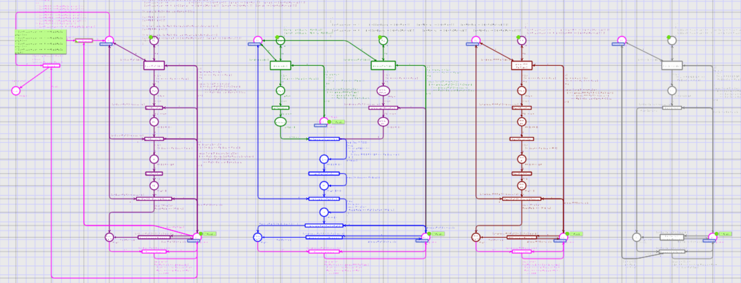
Finite state machine
General view of a finite state machine built using the CPN Tools software tool.

Slide 11
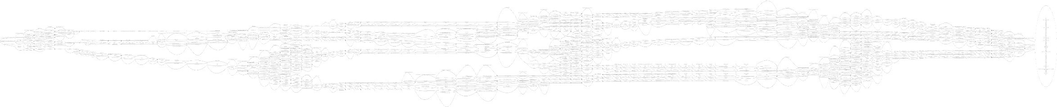
State space
The complete state space of the CS model based on a discretionary policy of differentiation of access rights.

Slide 12
Conclusion
In this paper, a method for constructing and proving a formal mathematical model was considered that implements the security functions of information security systems based on a discretionary access control policy. An approach is shown that implements the object-subject formalization.
An example of creating a finite state machine is shown using the CPN Tools software solution.

